Slide 1
Undersmoothed HAL-based plugin estimator for direct/indirect effects
Develop and test undersmoothed HAL-based plugin estimator for direct/indirect effects, or other more complex parameters.
Seraphina

Slide 2
Undersmoothing
Getting the initial lambda
from a HAL fit with smoothness_orders = 1
Getting the undersmoothed lambda:
Generate a panel of lambdas
CV lambda * seq(from=0, to=-3, length=20)
Pick the first lambda that satisfies the criteria:
Max score <= 1/(sqrt(n) * log(n))
Where max score = max(|E[(Y – Y_hat)(H/sigma_n)]|)

Slide 3
Controlled direct effects
Data structure:
W: baseline, continuous
A: treatment dosage, continuous, bounded
Y: outcome, binary
Causal target parameter:
Dose response curve, over grid of a

Slide 4
Controlled direct effects - simulations
Generate data with given sample size n with the given DGD
Fitting the Y ~ X directly with undersmoothed HAL using the sample once
max_degree = 3
smoothness_orders = 1
base_num_knots_0 = 20
base_num_knots_1 = 20
Estimating the targeted parameter by calculating the simple substitution estimator
Predicting given a
using the fitted undersmoothed HAL for all combinations of a

Slide 5
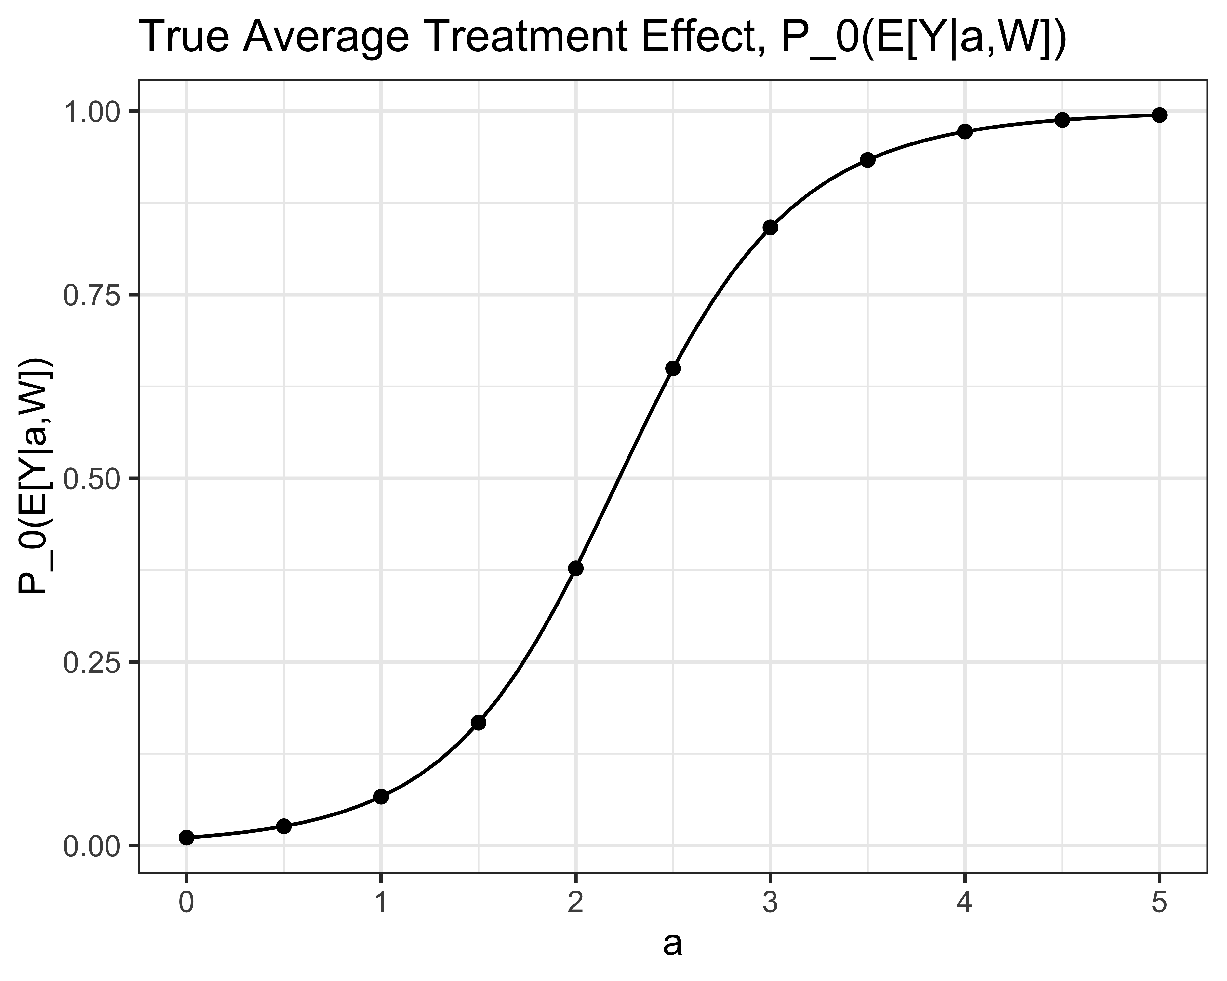
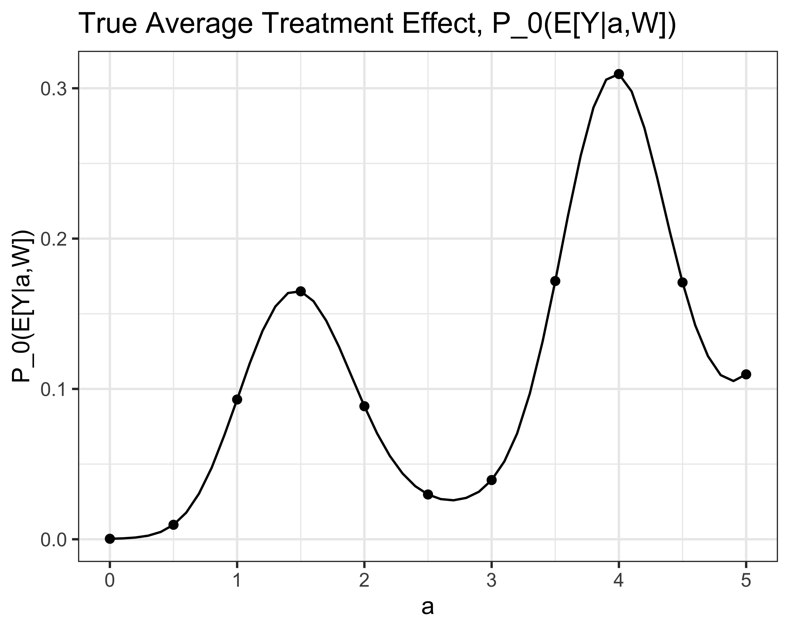
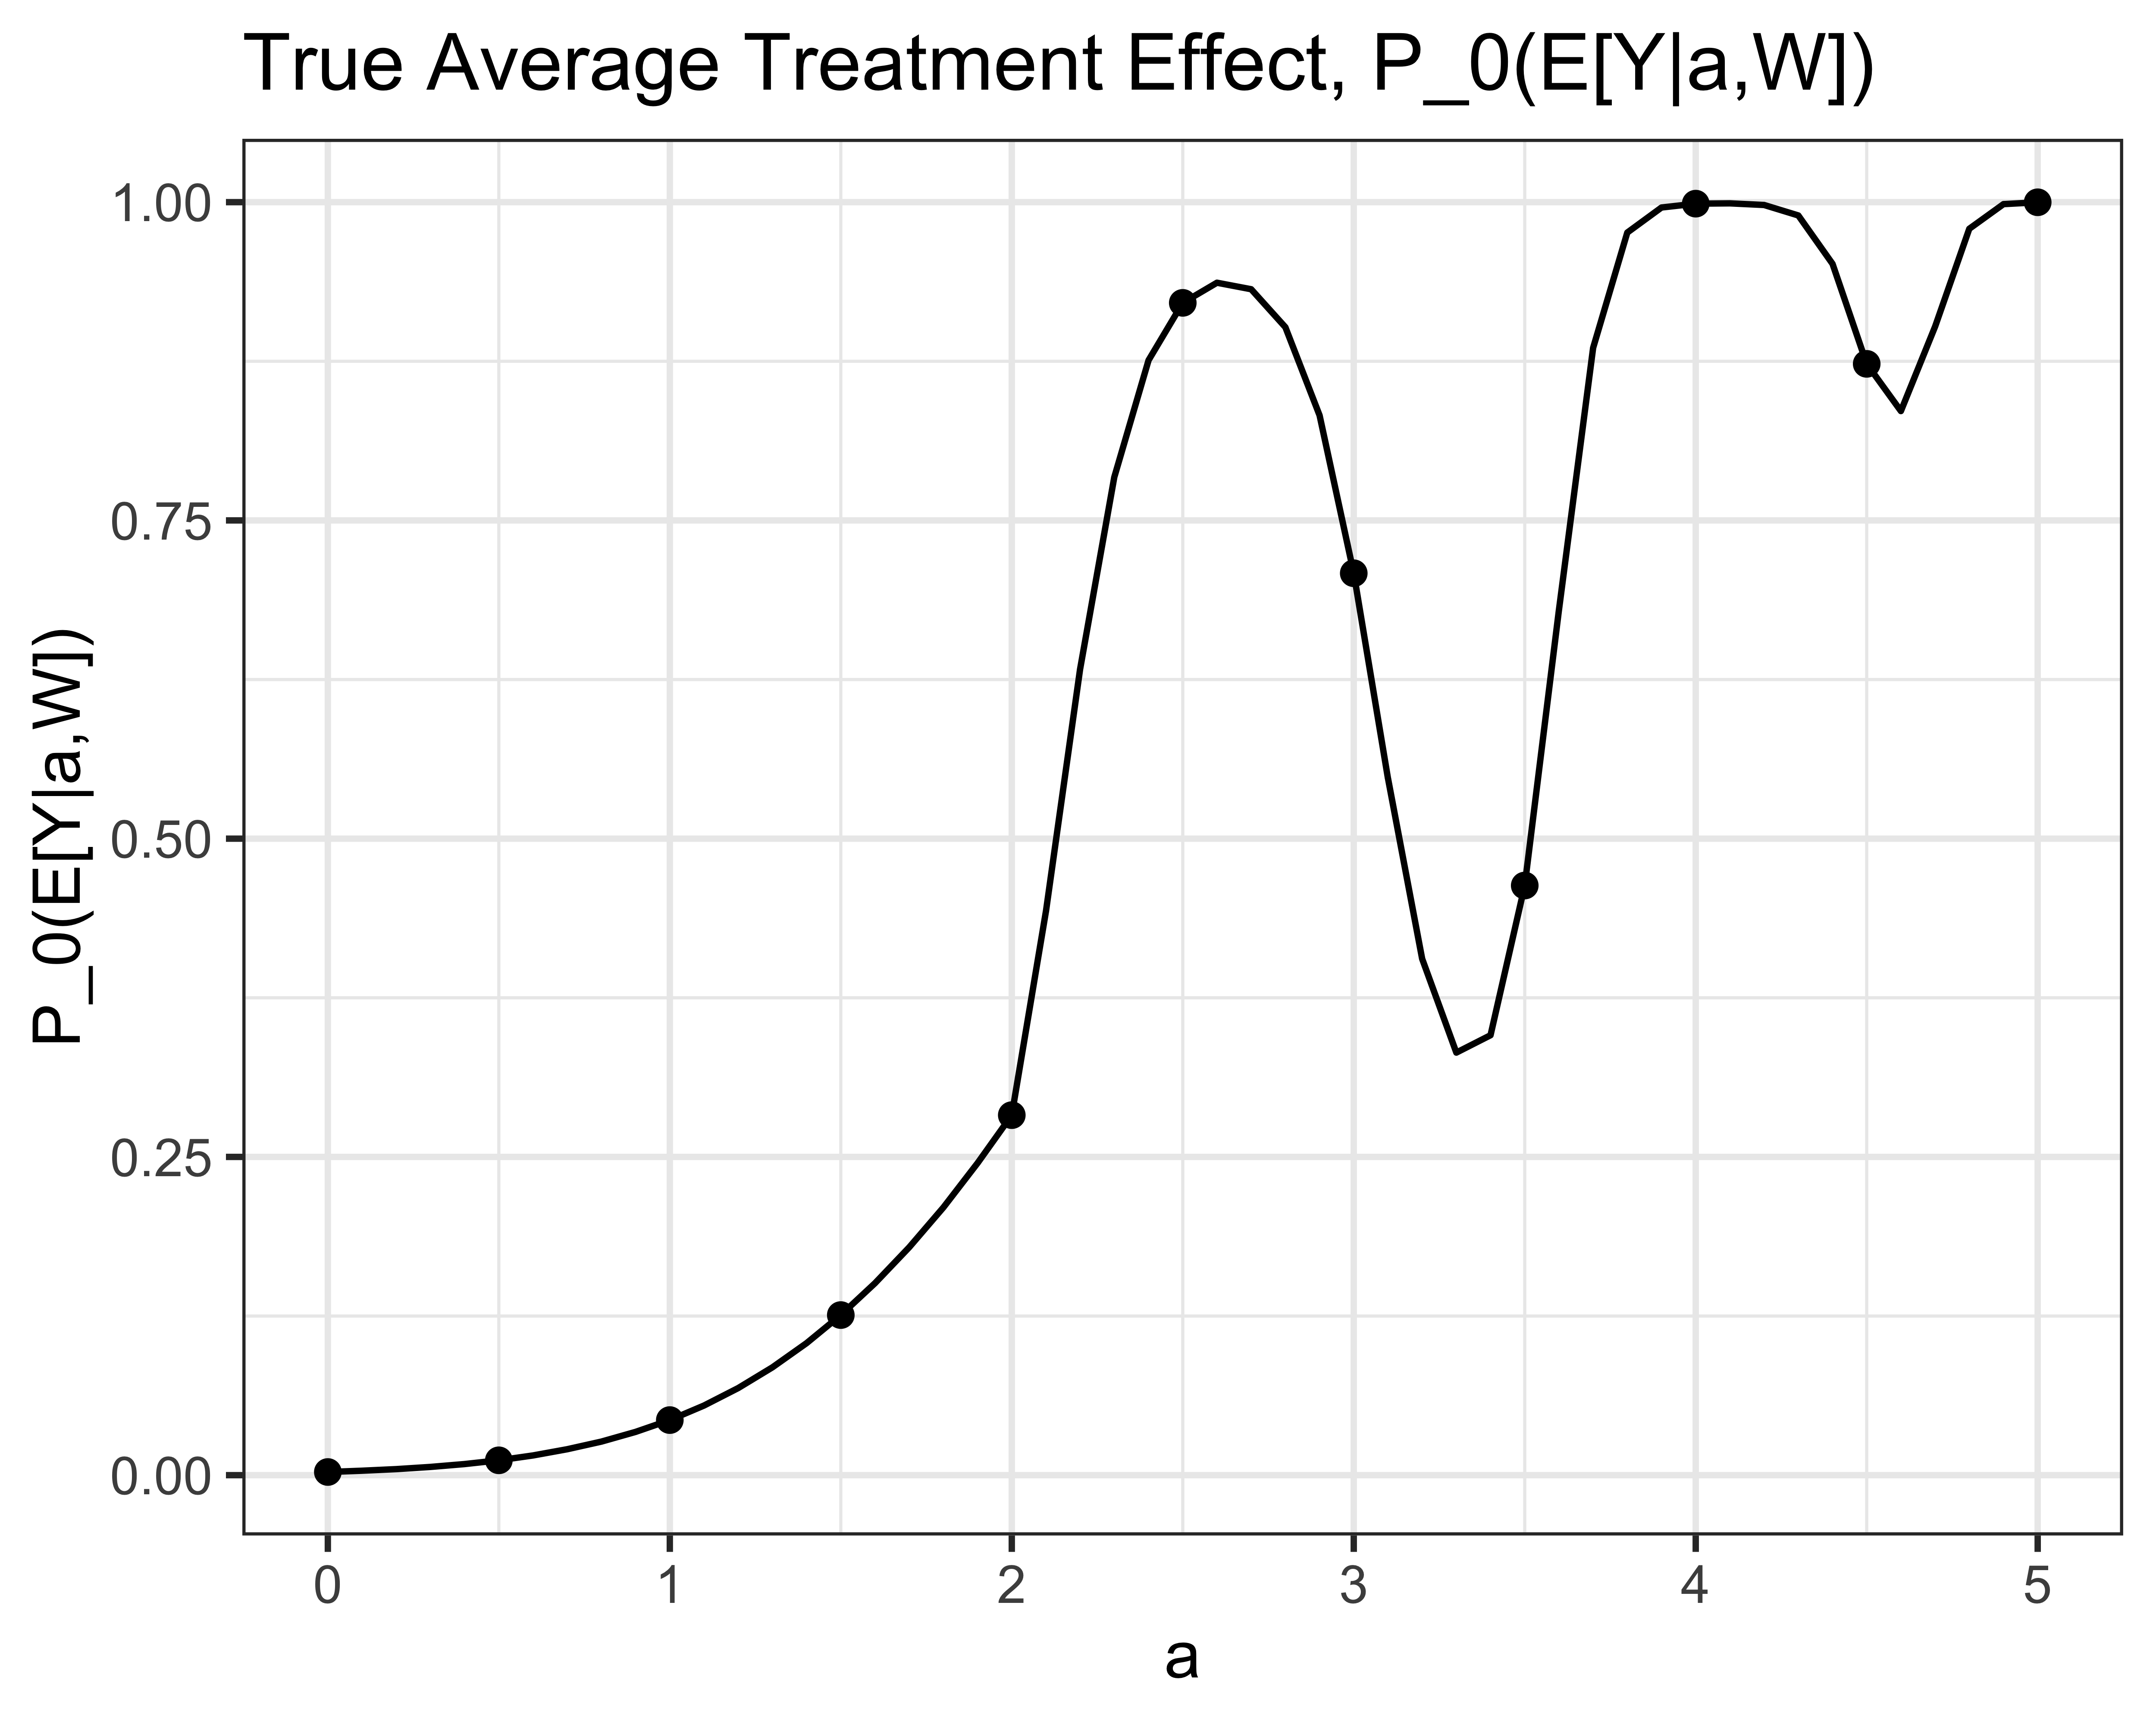
3 Simulations:

Slide 6
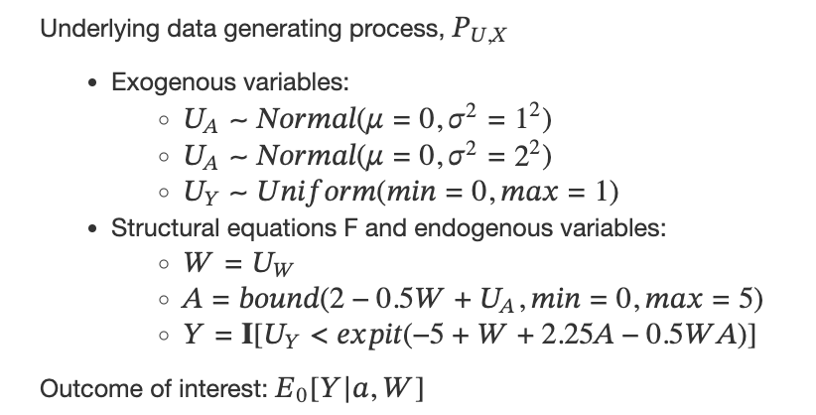
Simulation #1

Slide 7
n = 200
n = 500
n = 1000

Slide 8
n = 200
Proportion of simulations that cannot compute empirical SD:

Slide 9
n = 500
Proportion of simulations that cannot compute empirical SD:

Slide 10
n = 1000
Proportion of simulations that cannot compute empirical SD:

Slide 11
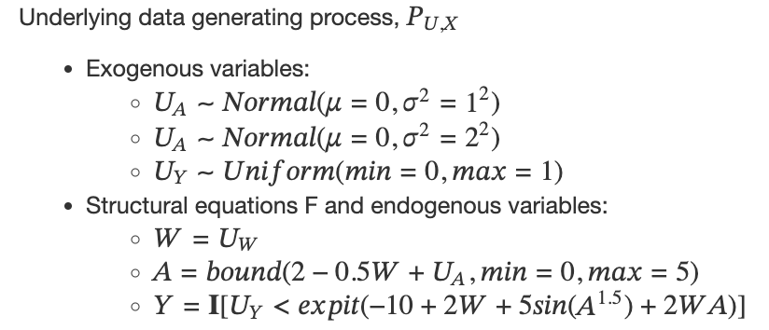
Simulation #2

Slide 12
n = 200
n = 500
n = 1000

Slide 13
n = 200
Proportion of simulations that cannot compute empirical SD:

Slide 14
n = 500
Proportion of simulations that cannot compute empirical SD:

Slide 15
n = 1000
Proportion of simulations that cannot compute empirical SD:

Slide 16
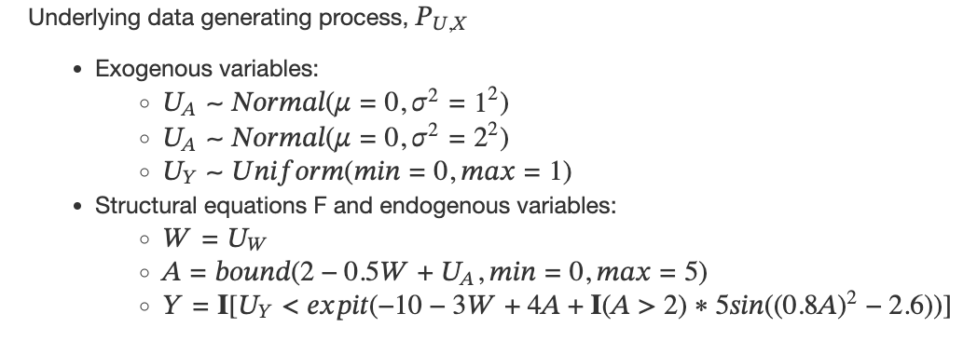
Simulation #3

Slide 17
n = 200
n = 500
n = 1000

Slide 18
n = 1000

Slide 19
n = 200
Proportion of simulations that cannot compute empirical SD:

Slide 20
n = 500
Proportion of simulations that cannot compute empirical SD:

Slide 21
n = 1000
Proportion of simulations that cannot compute empirical SD:

